Slide 1
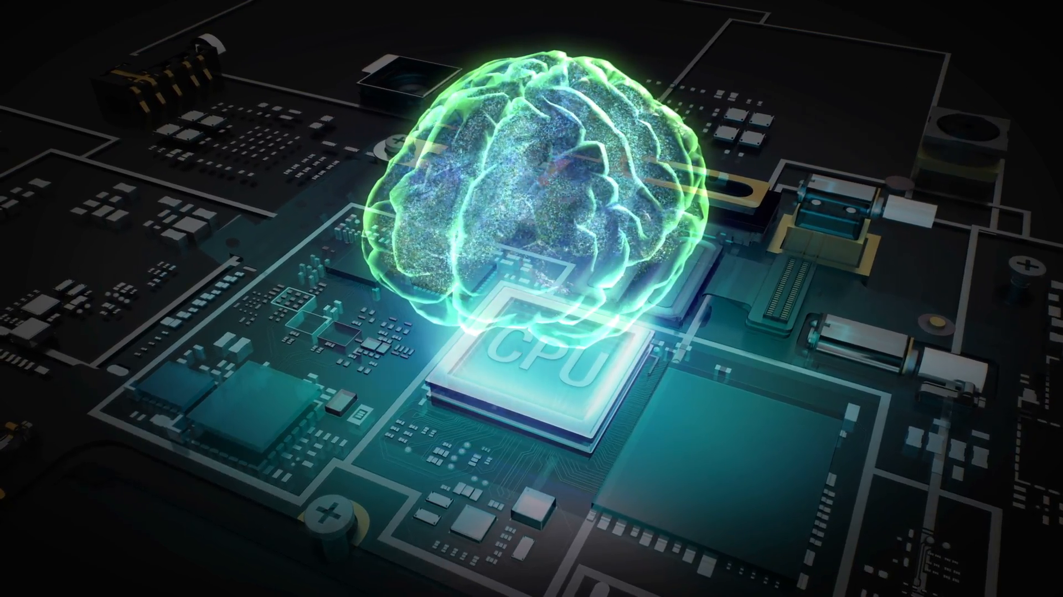
Am introducing you
MACHINE LEARNING
the power of computer science
SALEM SARTAWI

Slide 2
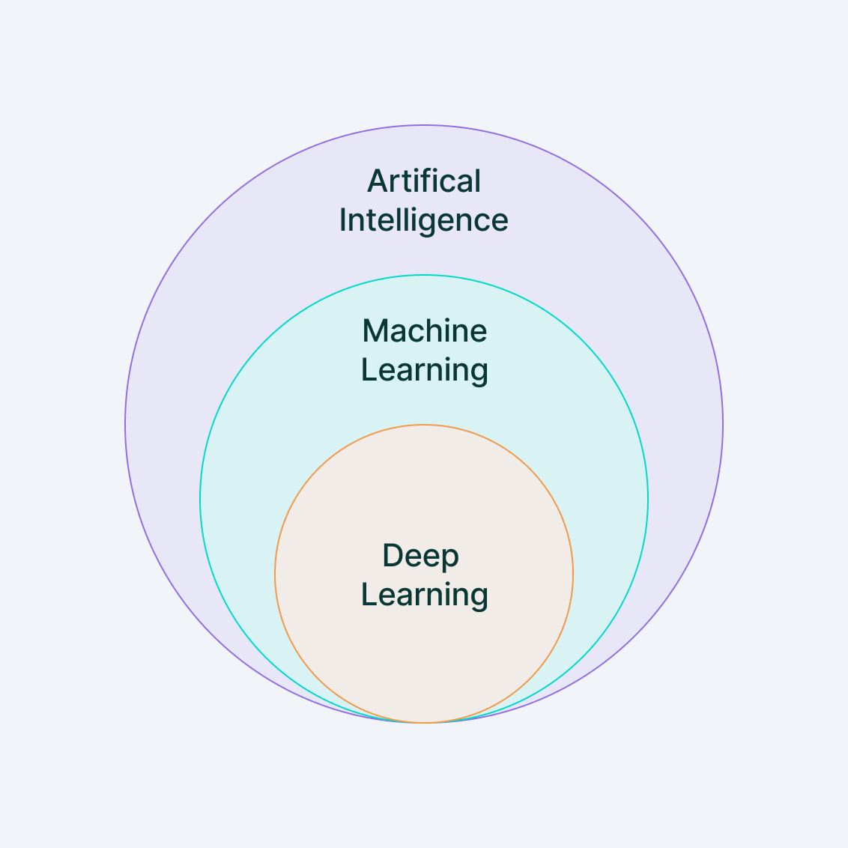
What is deep learning ?
A part from Machine learning
Introduced to make more complicated procedures for data
The Differnces with traditional machine learning extracting the features
Uses neural networks(NN) to understand unstructured data : images

Slide 3
Traditional machine learning
relies on domain knowledge and manual efforts to identify the best features for the model.
Deep learning
uses layers of neural networks to automatically discover the representations needed for the task directly from raw data.

Slide 4
My methodology
Age estimation with different deep learning models
L
E
s
T
C
STEP 01
Loading Dataset
STEP 05
Evaluation and improvments
STEP 02
Spliting the dataset
STEP 04
Tuning hyperparameters - overfit and underfit problems
STEP 03
CNN

Slide 5
Data set - UTKFace
A facial image indivisuals with an age range 0 - 116
The images cover large variation in pose, facial expression, illumination, occlusion, resolution, etc.
23,708
images
1k
30k
52% Males
48% Females

Slide 6
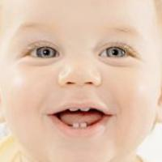

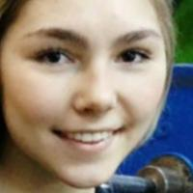
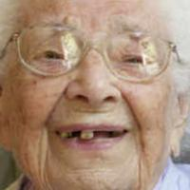
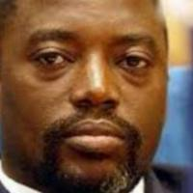

Data set - UTKFace
As we can see the UTKFace dataset contains images of faces labeled with ages.
It includes a wide range of ages, ethnicities, and genders, making it suitable for training robust age estimation models.
Image size : 200 x 200
AGE : 1
Image_path:
1_0_0_20161219192208688.jpg.chip.jpg
AGE : 58
Image_path:
58_0_4_20170120224545639.jpg.chip.jpg
AGE : 18
Image_path:
18_1_0_20170109213904824.jpg.chip.jpg
AGE : 105
Image_path:
105_1_0_20170112213001988.jpg.chip.jpg
AGE : 35
Image_path:
35_0_1_20170117104607288.jpg.chip.jpg
AGE : 26
Image_path:
26_0_3_20170117153347116.jpg.chip

Slide 7
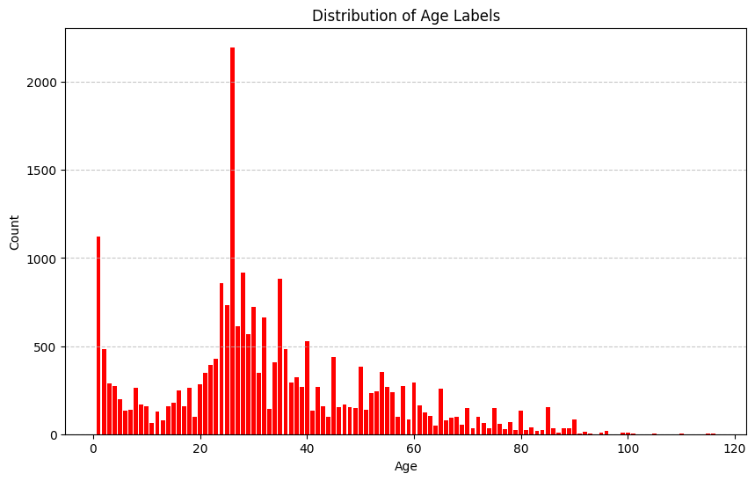
Age distrbution of UTKFace
As we can see, there are quite a lot images of persons with ages 1 and ages between 20 and 40 compared to other age ranges

Slide 8
Resizing and Normalizing the data
I resized the images into 150 x 150 as a starting point to see results
convert the images into vector matrices using the NumPy array
Normalization for the images pixel value to be in a range between 0 - 1

Slide 9
Spliting train_test
Having a kind of split there is no golden rule you can try out the split with your dataset
23,708
images
80%
20%
Training
18,966 images
Test
4,742 images

Slide 10
What is Convolutional Neural Network
Its a specialized type of neural networks and its a well suited for a tasks for image recognitions , classifications and regression tasks.
what makes CNN special when it comes into images automatically learns the features patterns from an input image through a multiple layers :
Convolutional layers
Pooling layers
Fully connected layer

Slide 11
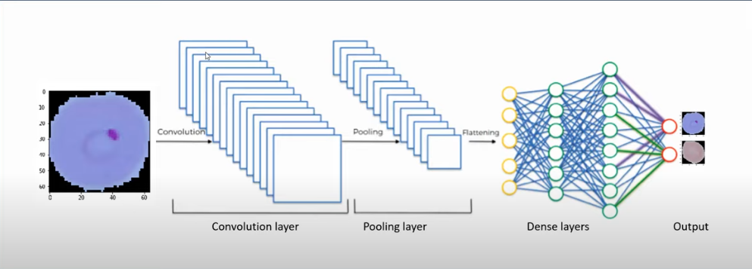
CNN architecture

Slide 12
Transfer learning - A way reducing the overfit
It’s a technique in deep learning where a model pre-trained on a large dataset is fine-tuned on a smaller, specific dataset for a related task.
This approach leverages the knowledge gained from the pre-trained model, allowing for faster training and improved performance, especially when data is limited. By reusing the learned features, transfer learning helps achieve better results with fewer resources.

Slide 13
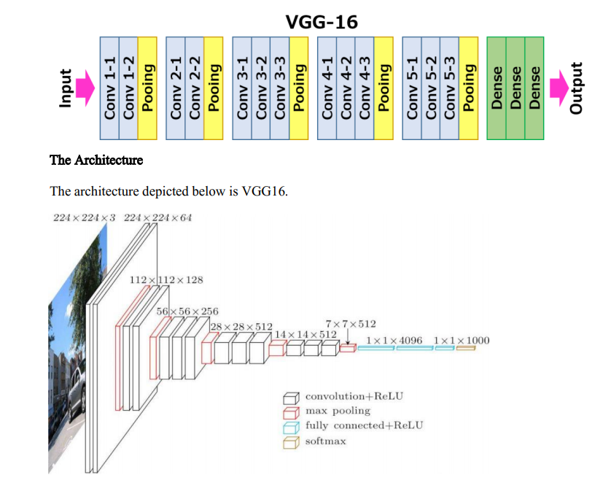
Transfer learning a pre-trained model CNN archeticture

Slide 14
What is MAE ?
Mean Absolute Error (MAE) is a commonly used metric and loss function in regression tasks used to calcualte the absolute difference between predicted and true value.
As a metric it evaluates the model performance.
As a loss function used to optimize parameters during training.

Slide 15
Tuning the hyperparameters
test_size : the number of sample test in spliting
Epoch : when the entire dataset is passed forward and backward through NN .
batch_size : number of training samples passed 1 forward and 1 backward
number of dense layers : the number of the fully connected layer
The rate of dropout : percent of dropped neuron on a specfic layer (0.4)

Slide 16
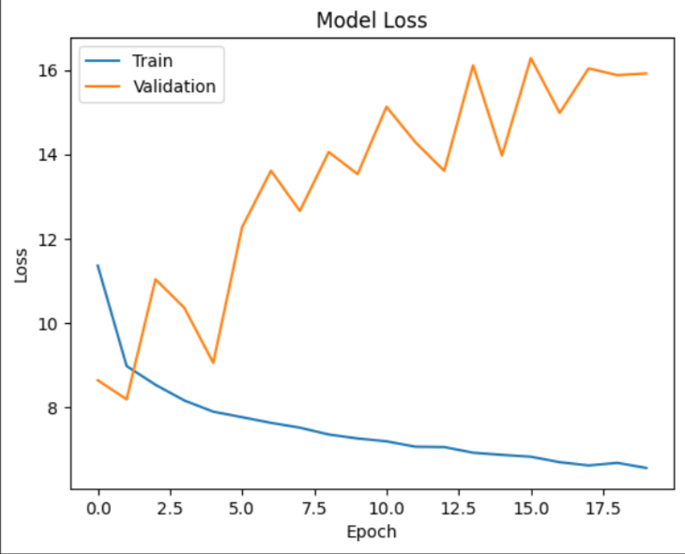
Overfitting problems
Tells me that the data and the model is working well with the training data but not as much with the validation “Model is not genralized enough” .

Slide 17
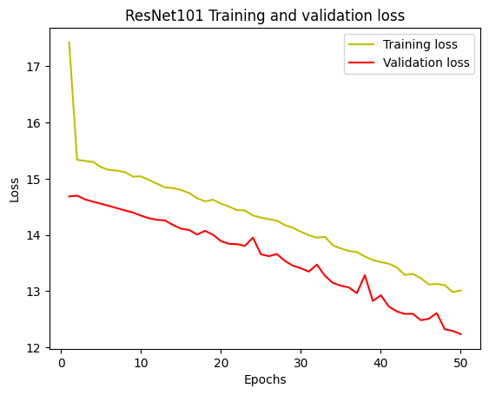
Underfitting problems
occurs when a model is too “simple”, failing to capture the underlying patterns in the data, resulting in poor performance on both training and validation sets.
Underfitting occurs when a model is too simplistic, failing to capture the underlying patterns in the data, resulting in poor performance on both training and validation sets.

Slide 18
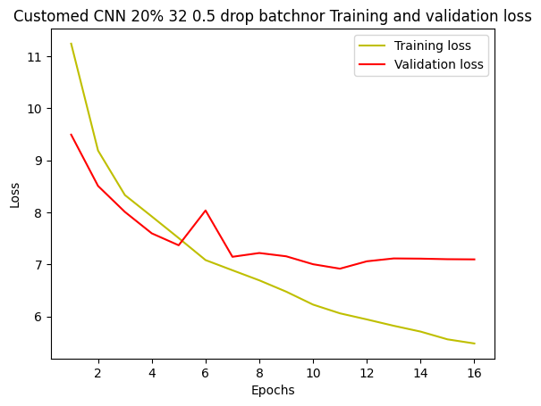
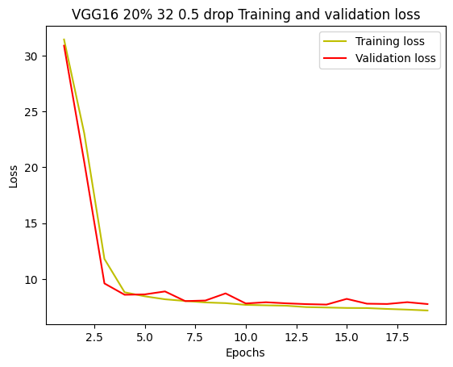
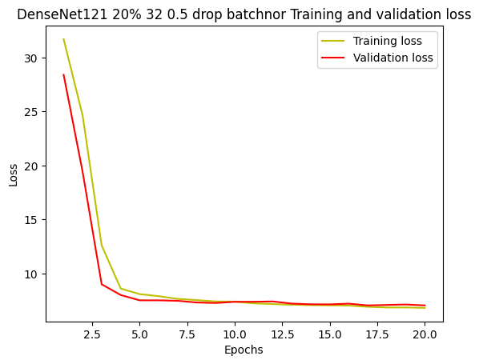
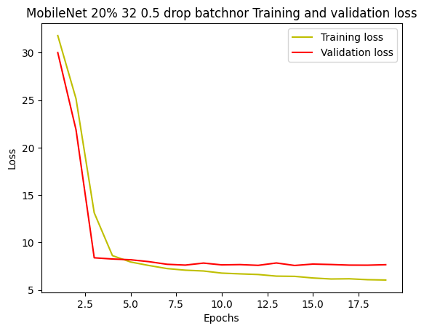
Different Graphs showing the improvments
CNN from scratch
VGG16
DenseNet121.
MobileNet

Slide 19
MAE score from different CNN models:
Started with a 80% 20% split , batch_size 32 , shuffling , 2 dense layers , dropout rate of (0.5)
 | DenseNet121 | MobileNet | VGG16 | VGG19 | Customed CNN
MAE | 7.05 | 7.58 | 7.71 | 8.22 | 9.20

Slide 20
DenseNet121taken into tuning hyperparameters
80% 20% | 2 dense 0.4 drop rate BatchNor
Batch 32 | 7.8
85% 15% | 1 dense 0.3 drop rate BatchNor | 1 dense 0.4 drop rate BatchNor | 1 dense 0.5 drop rate BatchNor
Batch 32 | 7.07 | 6.99 | 7.14
Batch 64 | 7.24 | 7.31 | 7.52

